Slide 1
Cloud Pricing Models
A comparison of AWS, Azure and GCP

Slide 2



Comparison of Main Cloud Price Model Options
On-demand Pay only for the instances used with no long-term commitments or upfront payments. | Spot Instances Spot instances allow to request spare computing capacity for a significant discount off the On-Demand prices. | Savings Plans Reduce costs by making a commitment to a consistent amount of usage (in USD / h) for a term of 1 or 3 years. | Reserved Instances Reduce costs by making a commitment to a specific instance configuration for a term of 1 or 3 years. | Further Plans Further reduction of costs for specific use cases.
Minimum of 60s After that per second billing | Up to 90% discount Eviction notice time: 120s Stop, Hibernate, Terminate (default) Options Stop and Hibernate allow to resume work | Up to 66% discount | Up to 72% discount Volume discounts Standard, convertible, scheduled Ris Marketplace available | Dedicated Hosts: Physical EC2 server dedicated for your use and allowing you to use your existing server-bound software licenses.
Per second billing | Up to 90% discount Eviction notice time: 30s Deallocate (default) or delete options Deallocate sets the instance to a stopped state to restart it later, but incurs storage costs | Up to 65% discount Up-front payment or monthly Usage that is more than the committed amount is charged with on-demand prices | Up to 72% discount Cancelation possible for a termination fee | Azure Hybrid benefit lets existing on-premises licenses apply towards Azure services, resulting in significant cost savings. Azure Dev/testing grants discounts for users doing development and testing
Minimum of 60s After that per second billing | Between 60% and 91% discount Eviction notice time: 30s Terminate (default) and delete options Able to resume work, but charged storage costs for underlying disks | Compute Engine flexible committed use discounts 28% on 1 year 46% on 3 years | Resource-based committed use discounts 37% on 1 year 57% on 3 years, 70% if it is a memory optimized machine | Sustained Use discounts: When CPU or memory is used 25% or more per month, discount is granted for every additional hour and can get up to 30%

Slide 3
Comparison of Cloud Instances and Prices
Anmerkung: Konkrete Instanzen vergleichbar mit 32 GiB memory und 16 vCPUs gewählt, leichter Unterschied in Network
General Purpose General purpose machine types with balanced CPU, memory and storage. Applicable for web apps, small to medium databases or microservices. Instances with 64 GiB and 16 vCPUs | Compute Optimized Ultra high performance for compute-intensive workloads like HPC, AI/ML or compute-bound workloads. Instances with 32 GiB and 16 vCPUs | Memory Optimized Ultra high memory performance workloads like medium to high OLAP or in-memory databases. Instances with 128 GiB and 16 vCPUs/192 GiB and 32 vCPUs | Benchmark Instances with the best vCPU to dollar ratio.
Best Instance m6g Series (e.g. m6g.4xlarge) Processor: 64-bit-ARM-Neoverse (AWS Graviton2) ca. 26 vCPUs/$ ca. 104 GiB/$ ca. 16 Gbps/$ Also available with Intel und AMD processors. | Best Instance c6g Series (e.g. c6g.4xlarge) Processor: 64-bit-ARM-Neoverse (AWS Graviton2) ca. 29 vCPUs/$ ca. 59 GiB/$ ca. 18 Gbps/$ Also available with Intel und AMD processors. | Best Instance r6g Series (e.g. r6g.4xlarge) Processor: 64-bit-ARM-Neoverse (AWS Graviton2) ca. 20 vCPUs/$ ca. 159 GiB/$ ca. 12 Gbps/$ Also available with Intel und AMD processors. | Best Instance a1 series (e.g. a1.4xlarge) Processor: 64-bit-ARM-Neoverse (AWS Graviton) ca. 39 vCPUs/$ ca. 78 GiB/$ ca. 25 Gbps/$ Not available with any other specifications.
Best Instance D Series (e.g. D16 v3) Processor: 2.3 GHz Intel® XEON ® E5-2673 v4 (Broadwell) ca. 21 vCPUs/$ ca. 83 GiB/$ ca. 10 Gbps/$ Also available with ARM and AMD processors. | Best Instance F Series (e.g. F16s v2) Processor: 2.7 GHz Intel Xeon® Platinum 8168 (SkyLake) ca. 24 vCPUs/$ ca. 47 GiB/$ ca. 10 Gbps/$ Only available with other Intel specifications. | Best Instance (E Series better) M Series (e.g. M32ts) Processor: Intel® Xeon® E7-8890 v3 2.5GHz (Haswell) ca. 12 vCPUs/$ ca. 71 GiB/$ ca. 3 Gbps/$ Also available with the Intel® Xeon® Platinum 8280M (Cascade Lake). | Best Instance HB Series (e.g. HB60rs) Processor: AMD EPYC 7551 ca. 26 vCPUs/$ ca. 105 GiB/$ - Gbps/$ Not available with any other specifications.
Best Instance N2D Series (e.g. n2d-highcpu-16) Processor: 2 gen. AMD EPYC Rome ca. 32 vCPUs/$ ca. 32 GiB/$ ca. 64 Gbps/$ Also available with 3 gen. AMD EPYC Milan processor. | Best Instance C2D Series (e.g. c2d-highcpu-16) Processor: 3 gen. AMD EPYC Milan ca. 27 vCPUs/$ ca. 53 GiB/$ ca. 53 Gbps/$ The C2 Series is also available on an Intel Scalable Processor (Cascade Lake) processor. | Best Instance M2 Series (e.g. m2-megamem-416) Processor: Intel Cascade Lake ca. 9 vCPUs/$ ca. 132 GiB/$ ca. 0.7 Gbps/$ Not available with any other specifications. | Best Instance E2 Series (e.g. e2-highcpu-16) Processor: 2 gen. AMD EPYC Rome ca. 40 vCPUs/$ ca. 40 GiB/$ ca. 40 Gbps/$ Also available with Intel processors.

Slide 4
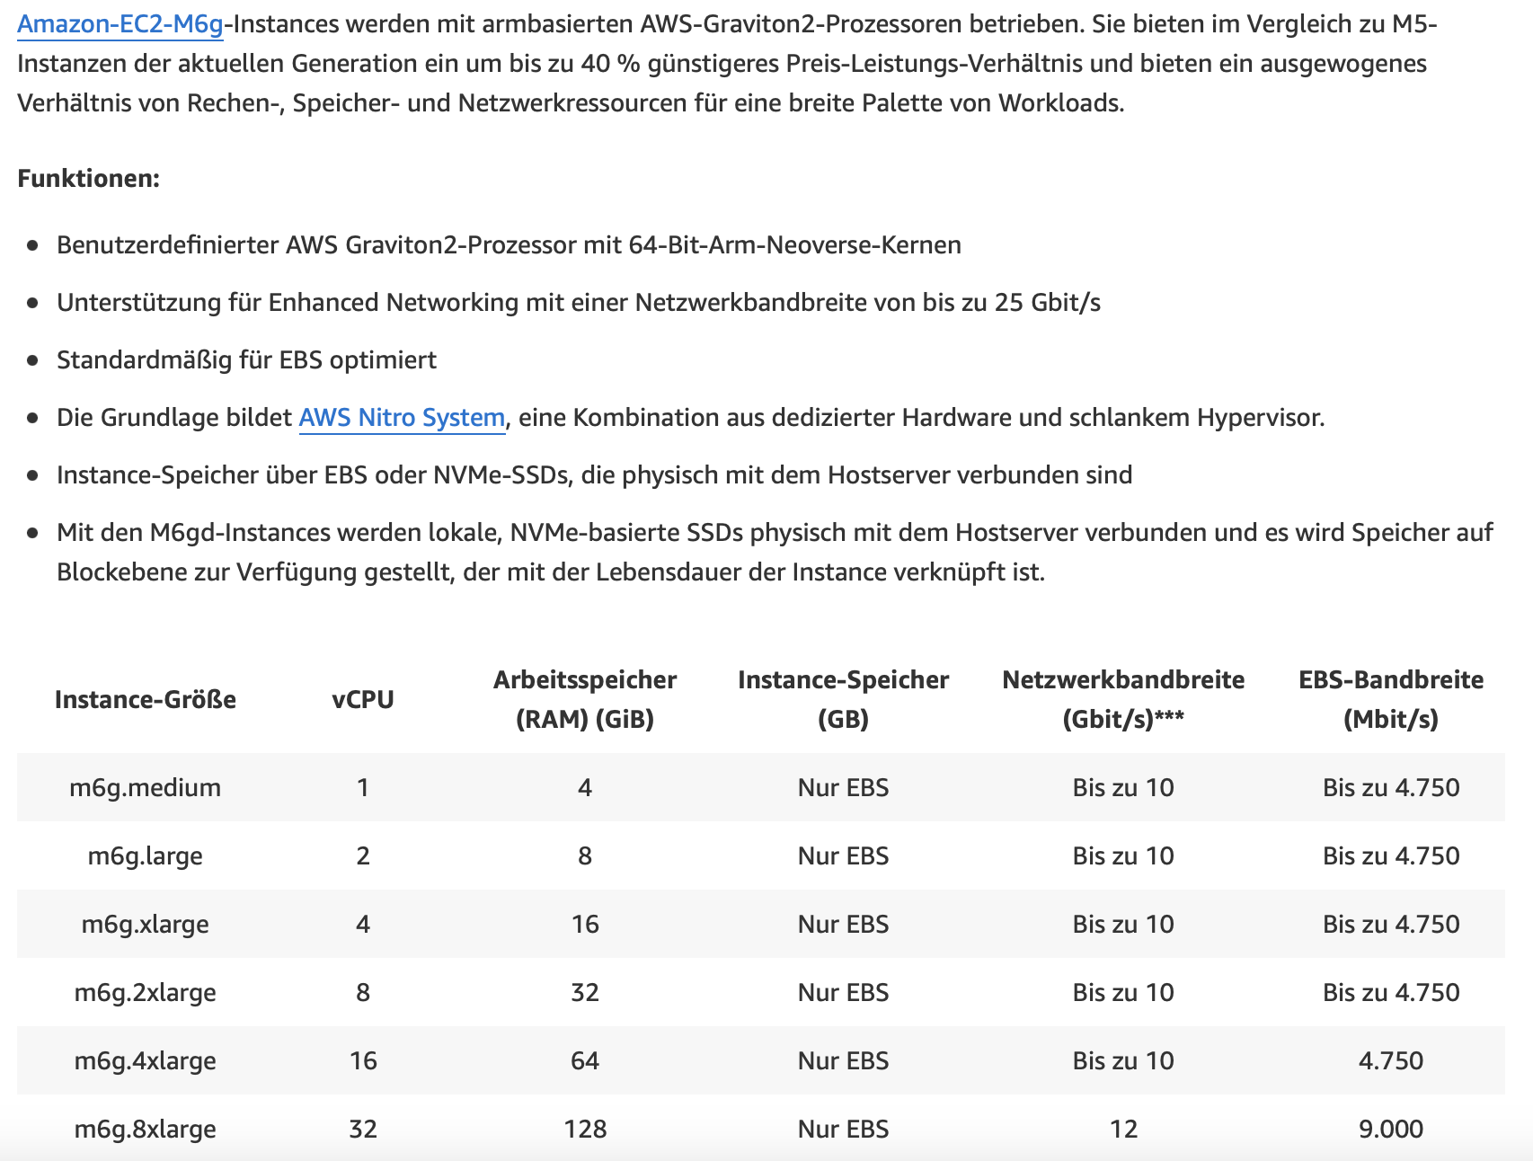
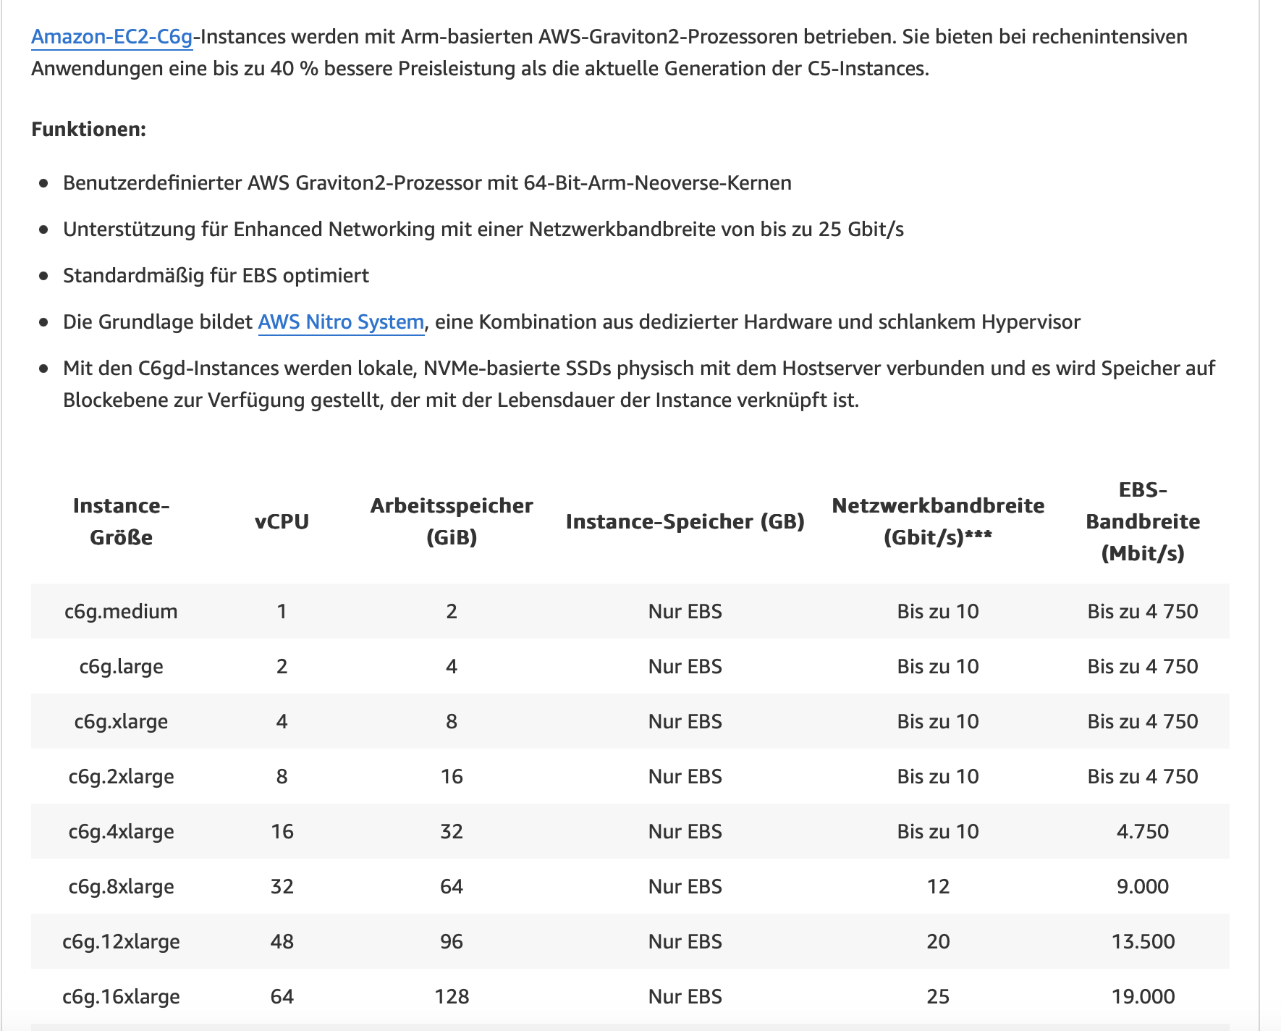
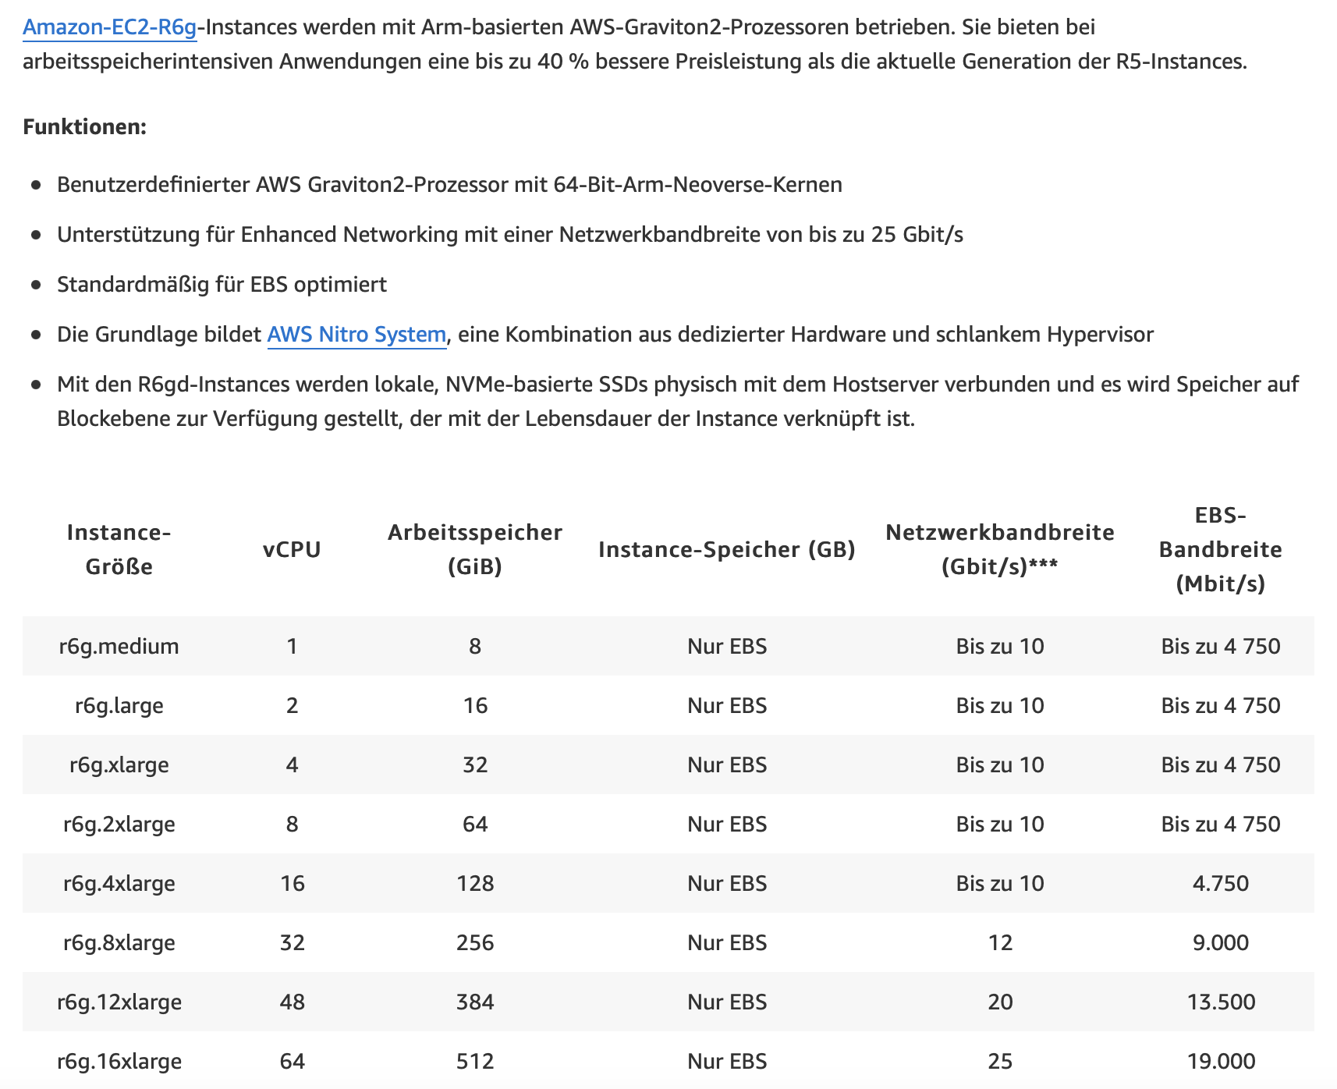
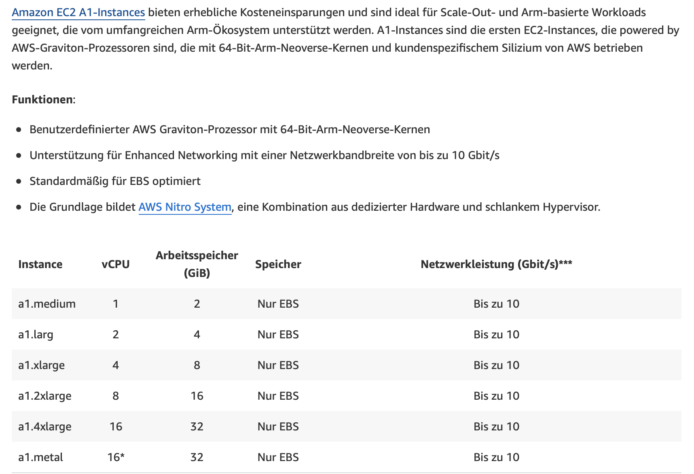
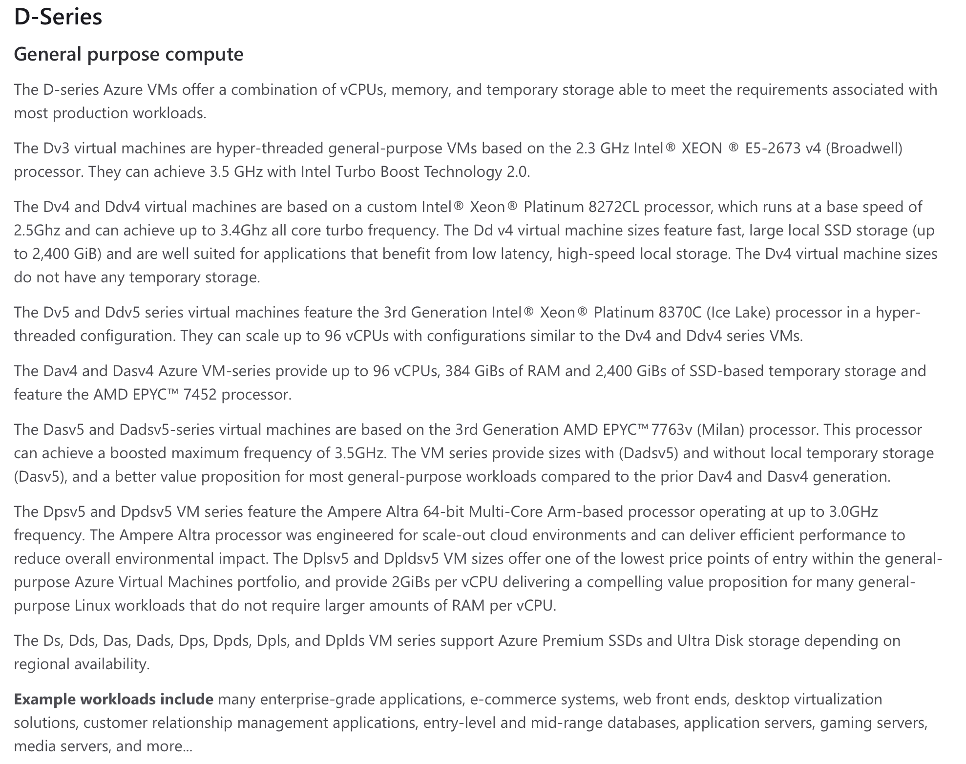
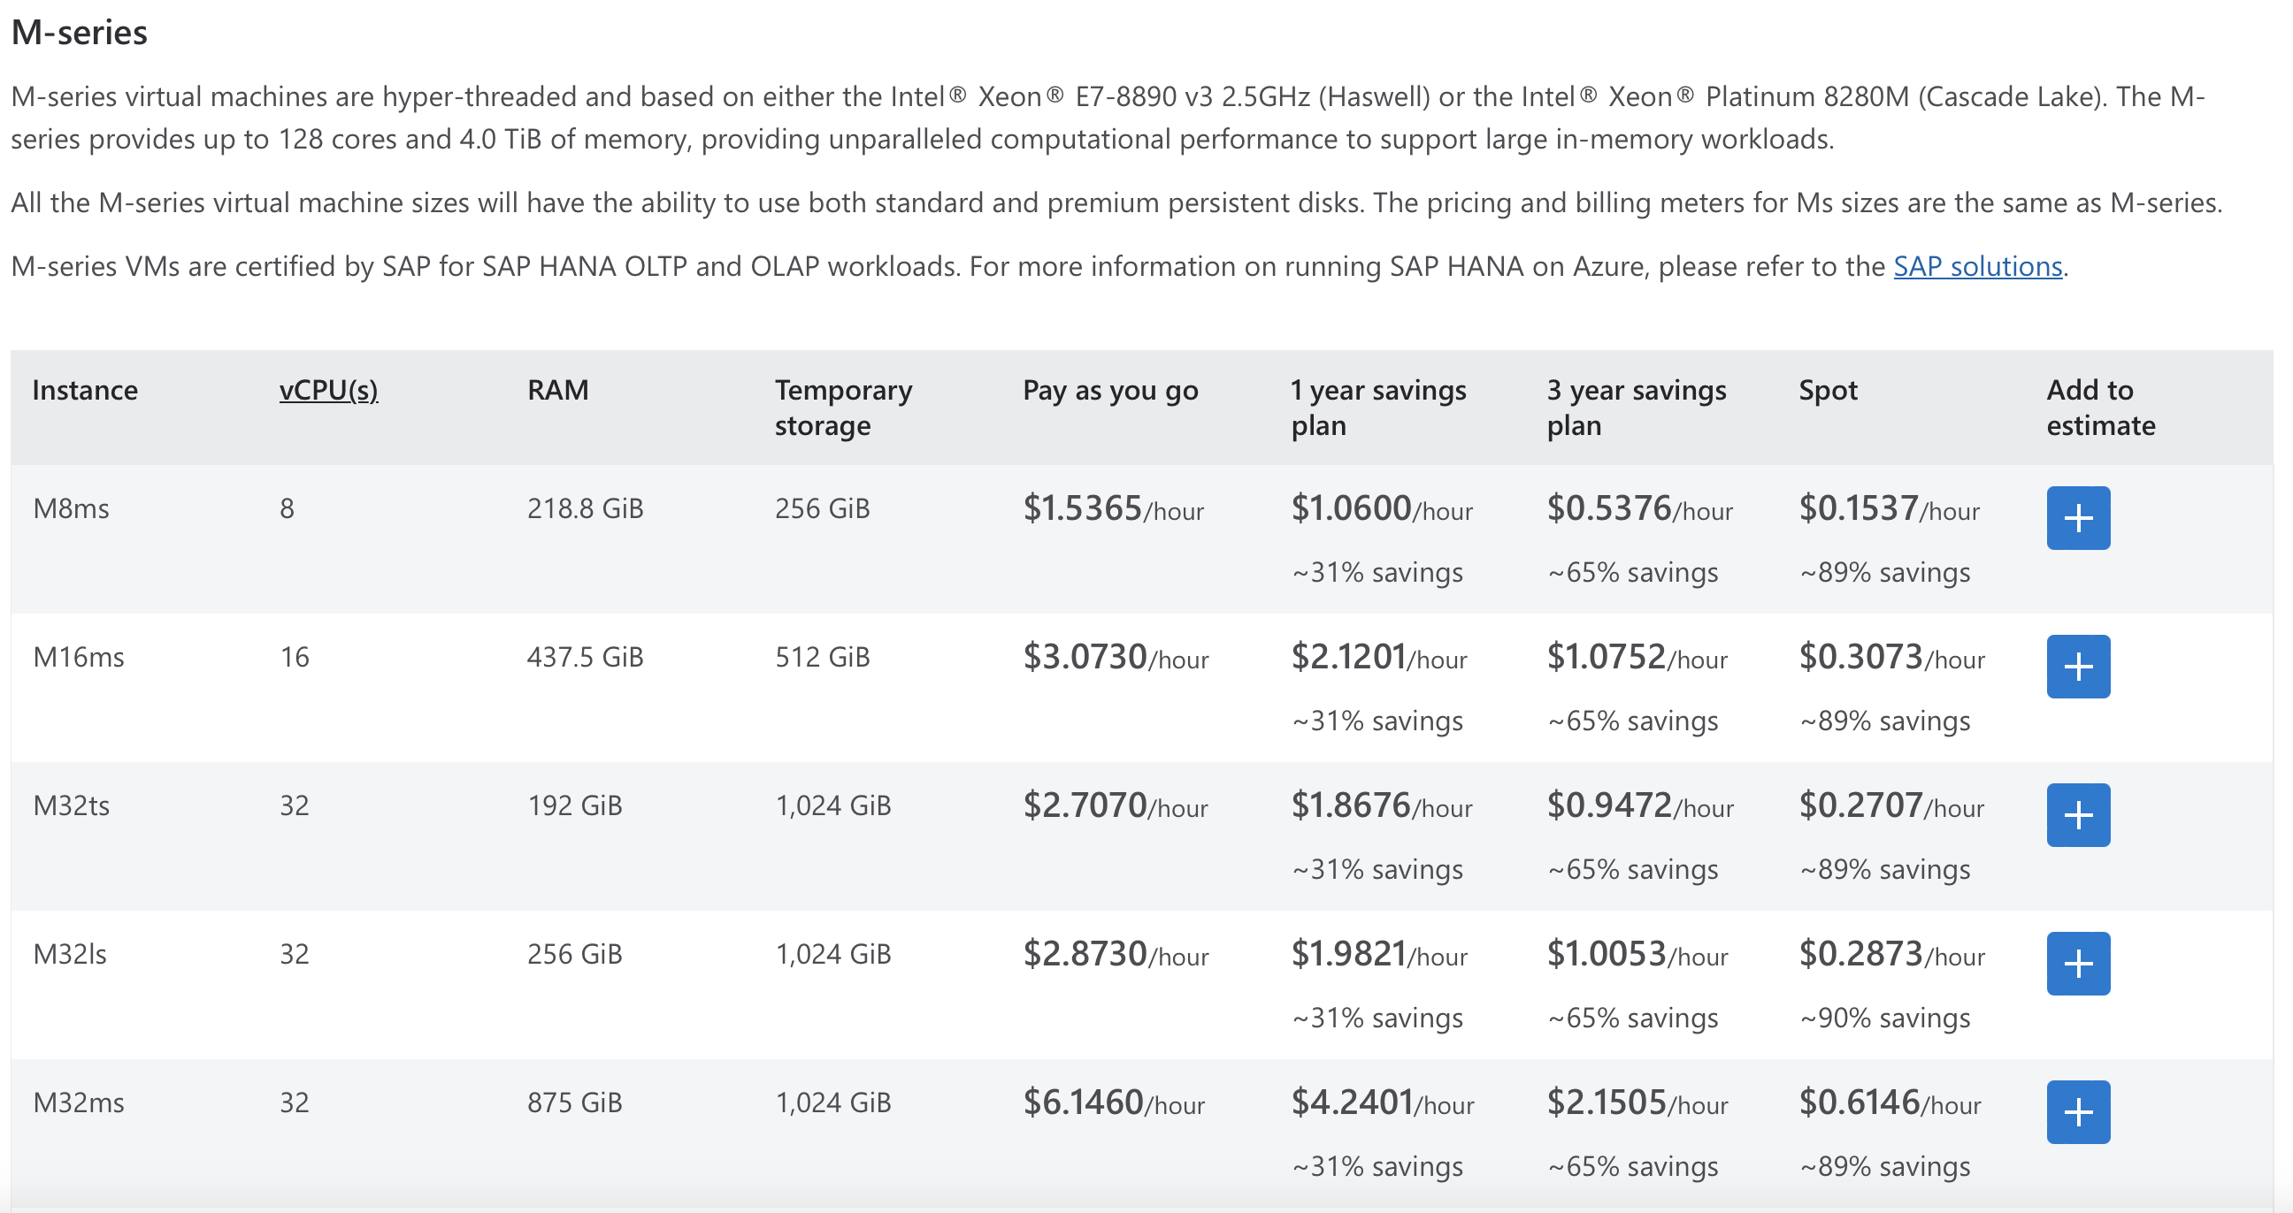
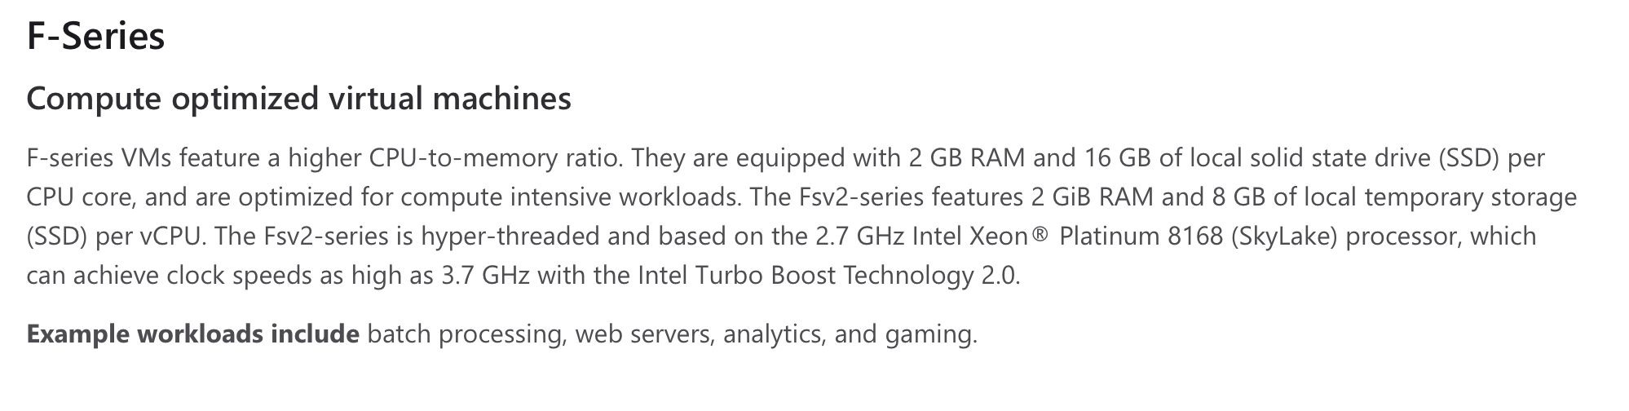
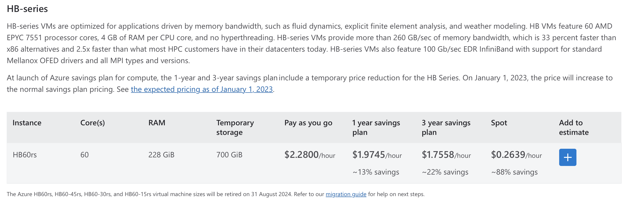
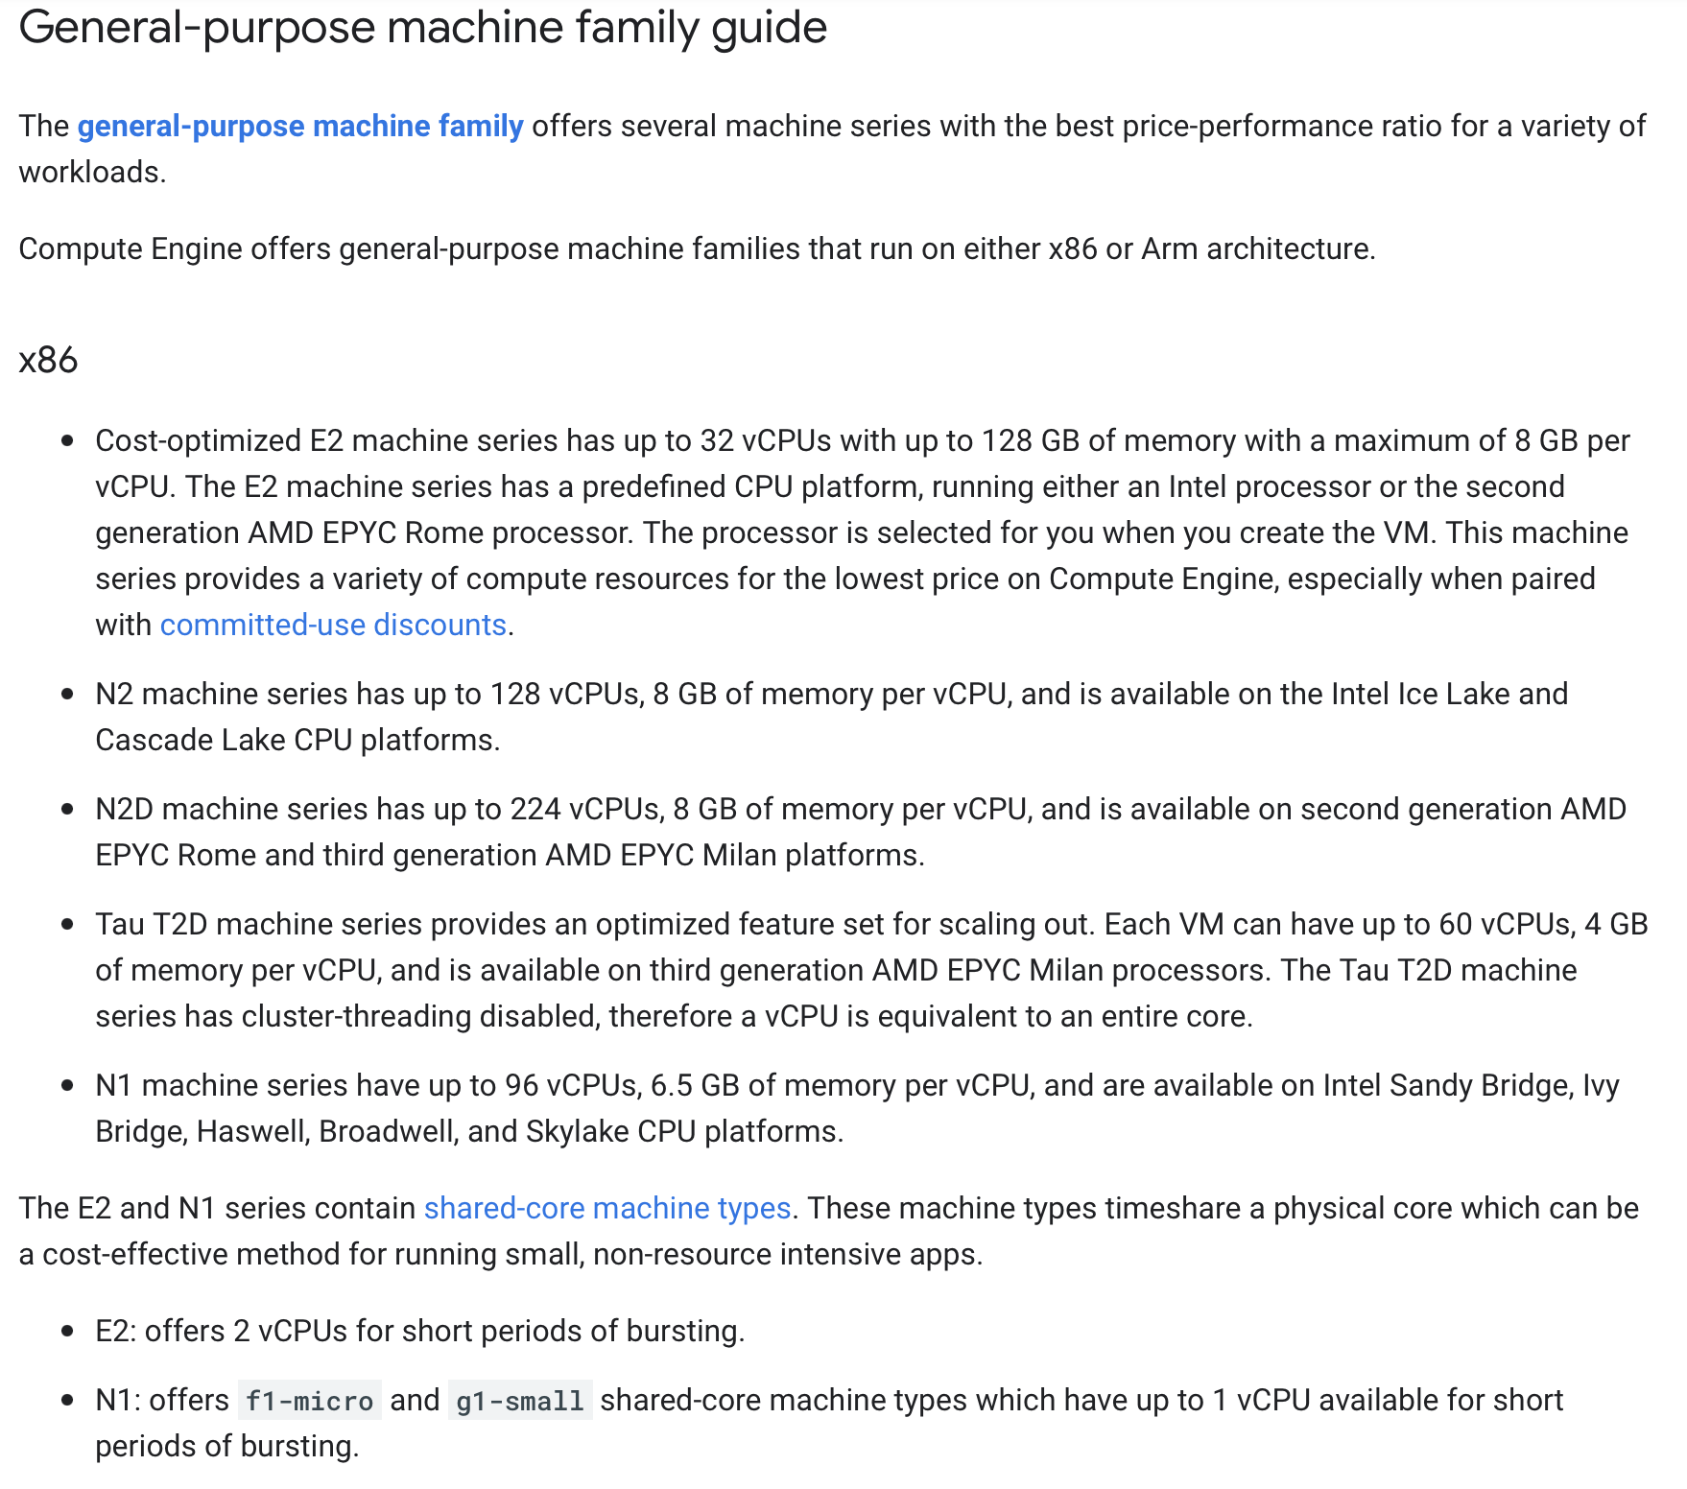
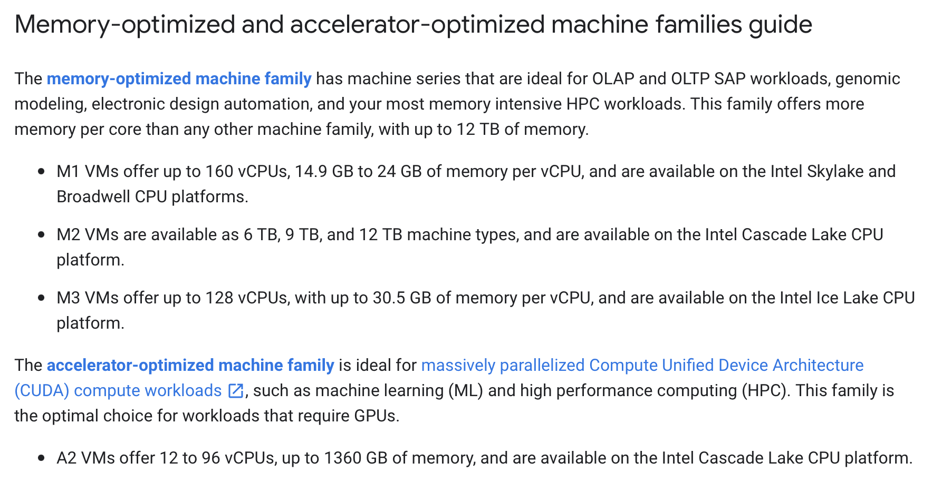
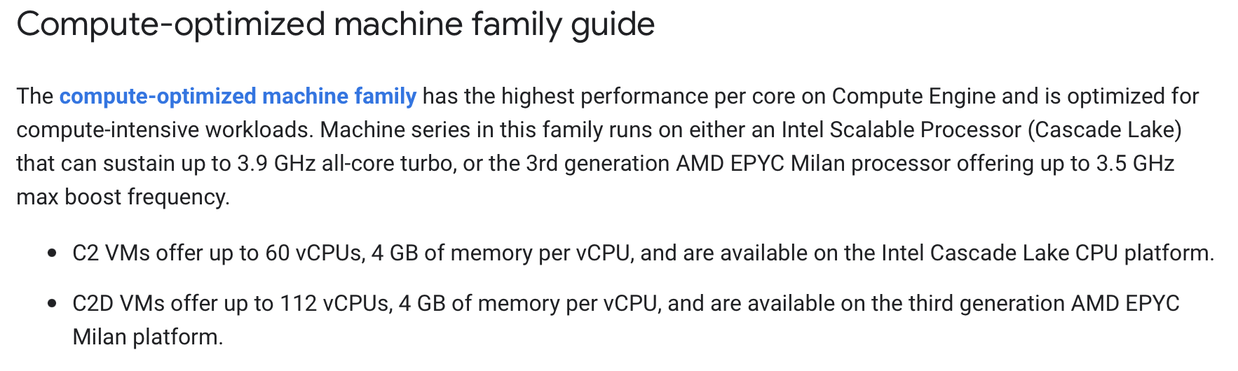
Backup Instances
https://aws.amazon.com/de/ec2/instance-types/
https://azure.microsoft.com/en-us/pricing/details/virtual-machines/series/#pricing
https://cloud.google.com/compute/docs/machine-resource

Slide 5
To-Dos
Jeweils die beste Instanz in CPU/$ raussuchen (exkl. Burstable Instanzen)
Network Bandwidth mit aufnehmen (bei Azure prüfen ob das wirklich die beste ist mit 32 GiB) -> keine Ahnung was very high bedeutet
Evtl. Screenshots aus R aufnehmen -> Savings Plans mit rein
Weitere Spalte aufnehmen
Deep Dive weglassen (bzw. als Backup) und alles in Tabelle schreiben
Parameter überarbeiten, ist dann aber Brainstorming
Zusätzliche Parameter erstmal nicht wichtig
Überarbeiten der ersten Slide + wichtige Facts fett
Tabelle auf zweiter Slide kleiner + R vorbereiten
Storyline abrunden
Auf github pushen

Slide 6
Gegenüberstellung konkrete Preise -> Rechnungen
AWS
General Purpose
CPU optimized
Azure
General Purpose
CPU optimized
GCP
General Purpose
CPU optimized

Slide 7

Welche Parameter sind für einen Algorithmus relevant
Hardware requirements = Eingabe:
Wie viele vCPUs werden mindestens benötigt?
Wie viel memory wird mindestens benötigt?
Welche Network performance wird mindestens benötigt?
Wie lange wird/werden die Instanz(en) benötigt?
Zusatz?
Was ist das übergeordnete Ziel (z.B. general purpose use cases vs. CPU optimized zur Auswahl der Instanzfamilie??)
Ist der workload fehlertolerant, etc. oder nicht, d.h. können Spot Instanzen verwendet werden?
Instanz + Preis = Ausgabe:
Welche Instanz in welcher Preisoption ist Preisoptimal für die gegebenen Parameter
Was muss der Algorithmus können:
Parameter als Input nehmen
On-demand Preise kennen
Wissen, bei welchen Voraussetzungen für Rabatte auf Savingsplans gelten
Auf Basis von historischen Daten Spotpreise mit einbeziehen
Monetäre Bewertung wenn Spot Instanz verloren geht (evtl. einfach auf nächst schlechtere switchen)

Slide 8
Welche Parameter spielen noch eine Rolle
IOPS
Storage
EBS / SSD

Slide 9
Comparison of Price model options
AWS EC2
Azure VMs
Google Compute Engine
On-demand
Pay for the instances that you use by the second (with a minimum of 60s), with no long-term commitments or upfront payments.
Spot Instances
Spot instances allow you to request spare Amazon EC2 computing capacity for up to 90% off the On-Demand prices.
On-demand
Pay for the instances that you use by the second (with a minimum of 60s), with no long-term commitments or upfront payments.
Spot Instances
Spot instances allow you to request spare Amazon EC2 computing capacity for up to 90% off the On-Demand prices.
On-demand
Pay for the instances that you use by the second (with a minimum of 60s), with no long-term commitments or upfront payments.
Spot Instances
Spot instances allow you to request spare Amazon EC2 computing capacity for up to 90% off the On-Demand prices.
Savings Plans
You can reduce Amazon EC2 costs by making a commitment to a consistent amount of usage (in USD / h) for a term of 1 or 3 years.
Reserved Instances
You can reduce your Amazon EC2 costs by making a commitment to a specific instance configuration, (e.g. instance type or Region) for a term of 1 or 3 years.
Savings Plans
You can reduce Amazon EC2 costs by making a commitment to a consistent amount of usage (in USD / h) for a term of 1 or 3 years.
Reserved Instances
You can reduce your Amazon EC2 costs by making a commitment to a specific instance configuration, (e.g. instance type or Region) for a term of 1 or 3 years.
Savings Plans
You can reduce Amazon EC2 costs by making a commitment to a consistent amount of usage (in USD / h) for a term of 1 or 3 years.
Reserved Instances
You can reduce your Amazon EC2 costs by making a commitment to a specific instance configuration, (e.g. instance type or Region) for a term of 1 or 3 years.

Slide 10
Deep dive Spot / Savings / Reserved?
Genaue Unterschiede aufzeigen (z.B. ab wann wie lange wird ein discount gegeben, wie viel Zeit und welche Optionen hat man bei Spot Eviction)

